Slide 1

Welcome
Asset management
Analysis methods
CM & NDT
Statistical Analysis
of
Inspection Data
for
Probabilistic Risk Assessments
www.quanty.com.au
Presented by Yury Sokolov
Notes:
Dear colleagues, thank you for attending this presentation
‘Statistical analysis of inspection data for probabilistic risk assessments’.
The topic may sound quite specific, but will endeavor showing that it directly concerns:
Asset Management services, Condition monitoring and NDT vendors.
This is because we all operate in a common loop or risk management
and the capabilities of our tools affect each other.
In my view, the problem of implementing new tools originates from the data analysis element.
We will see how it happens and what solution we found for this problem.

Slide 2

Loop of Participants
CLIENT
Monitor
Assess
Control
THREE PARTIES
Client team
Inspection contractor
Integrity
contractor
RISK
www.quanty.com.au
5
Notes:
There are three major parties participating in the risk management loop: client, inspection contractor and integrity analysis contractor.
‘Client’ refers to the management and financial personnel of the risk owner.
Introducing new technologies (such as asset management, advanced NDT, live CM) requires substantiation of added costs within the client teams.
In this way, there should be an additional value obtained from the collected integrity data as the output of the analysis stage.
That additional value should ultimately be in a form of a clear cost/benefit analysis suitable for financial teams decision making.
Thus, an attempt to implement new technologies without a clear financial justification has a little chance of success.
Now we will assemble three puzzles showing this interaction in the past, present and future.

Slide 3
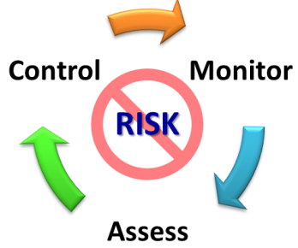
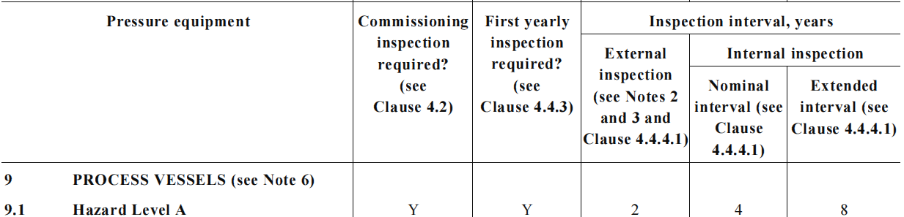

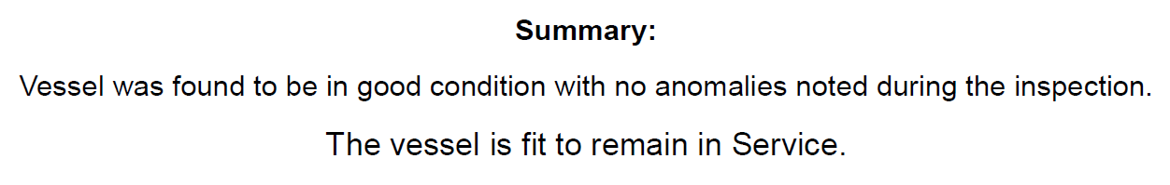
Puzzle 1 – Statutory regime
Fixed intervals
Shutdown and cleaning
KPI outputs,
Risks unknown
Legislative requirements
Visual Inspections
Statutory compliance
PAST
www.quanty.com.au
3
Notes:
Historically, the risk management loop was firstly addressed using a statutory inspection regime.
If we flatten the risk management wheel into a straight line, we will see such a sequence of elements.
Legislative requirements do set minimum requirements for assuring the plant operation safety.
In our context, these are the fixed inspection frequencies applicable to various equipment types.
Visual inspections are typically used to address this requirement, and provide qualitative conclusions on the equipment condition.
The downside of the visuals is the requirement to shutdown and clean the equipment, meaning a plant shutdown for inspection purposes.
Since the equipment has been inspected, KPIs are populated and a statutory compliance is achieved.
The message from this slide is that the statutory regime doesn’t provide sufficient numeric inputs for Asset Management,
and doesn’t require advanced Condition Monitoring or NDT tools, except for Fitness For Service situations.
Luckily, this situation often belongs to the past times, as inspecting such a size plant at the fixed regime would require a continuous shutdown.

Slide 4
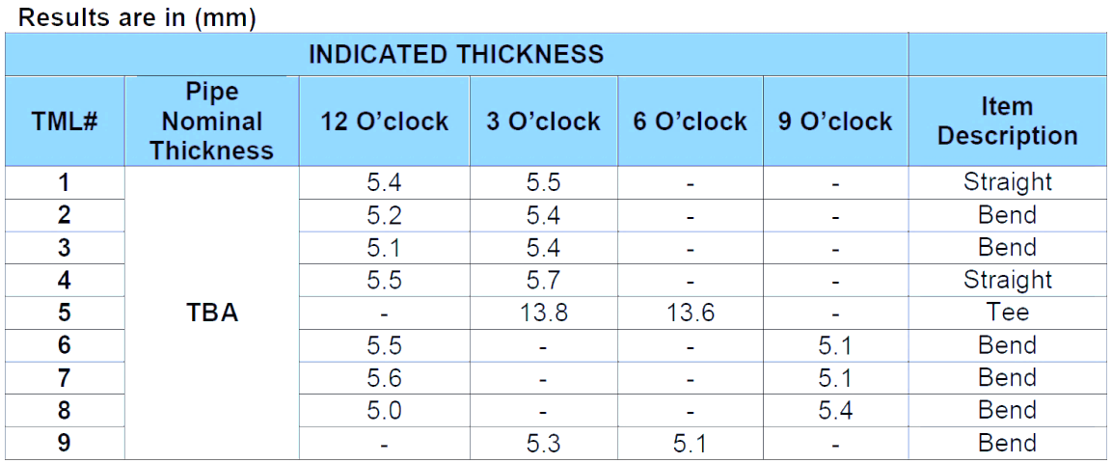
Puzzle 2 – typical RBI approach
Relative risk ranking
Coverage issue, worst case data
Cost/benefit unknown
Risk matrix driven
Manual UT, DPI, X-ray
RL=CA/CR,
Semi-Q risk
PRESENT
www.quanty.com.au
4
Notes:
The statutory regime shortcomings drove its evolution into the RBI (Risk Based Inspection) planning.
Focused on optimizing the inspection frequencies and budgets of individual equipment.
The process starts and ends with the risk owner’s risk matrix, which is nearly mandatory in a modern hazardous plant risk management.
Basic inspection tools are used to collect ‘worst case’ damage data across higher risk equipment, leaving lower risks for later.
The constant RL estimates are made from the worst case corrosion data and are then mapped into the risk matrix.
These ratings are dimensionless and so is the estimated risk level of a relative and comparative nature.
There is no output of risk cost and safety exposure versus time, due to unknown failure probabilities. This is the present situation.
Therefore, the asset management framework is not provided with a cost/benefit data,
and the advanced CM tools are, again, deployed mostly in Fitness for Service scenarios, which are infrequent.
This is the present practice in oil&gas industry, which can be upgraded to probabilistic risk and cost/benefit assessments using our methodology.

Slide 5
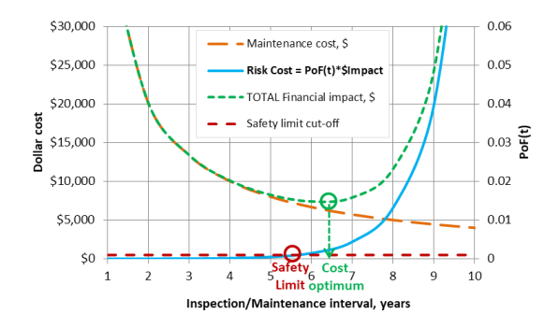
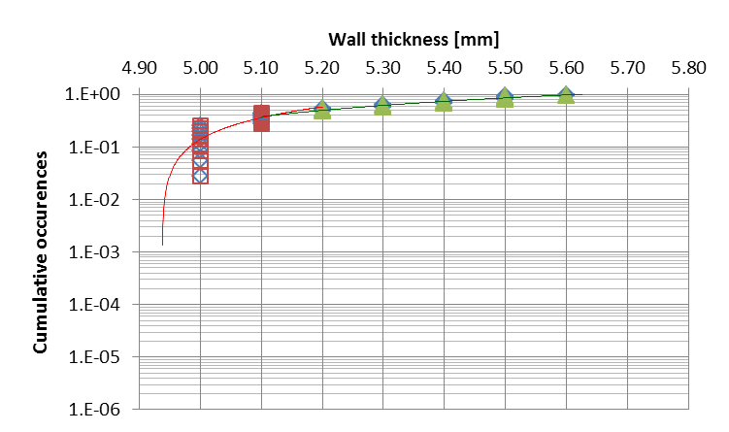
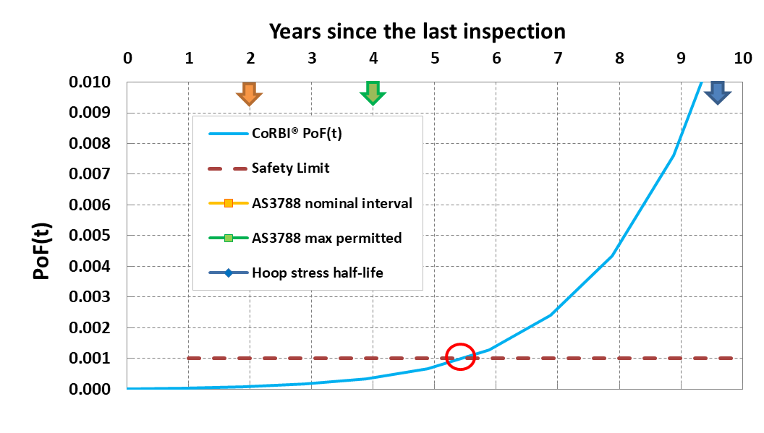
Puzzle 3 – PoF(t) analysis
Clear financial argumentation
Qualification made from data
Cost/Safety predictions
Cost/Benefit
driven
Statistical data analysis
Data -> PoF(t)
-> Risk Cost(t)
FUTURE
www.quanty.com.au
5
Notes:
This is again, a loop of risk management which starts and ends with cost/benefit considerations.
The shown cost/benefit graph is fully compatible to sustain business decisions in equipment integrity.
What we do is providing the blue cure, the Risk cost curve to asset managers and client teams.
This blue curve originates from a statistical analysis of evidential integrity data.
This analysis itself enables the inspection qualification, inspection coverage conclusions, and inspection tools recommendations.
The statistical data plots are next converted in the individual failure probabilities, which are fed into the cost/benefit analysis.
We can also establish the time instance of safety limits breach using this methodology (refer the red circle) and assure a genuine safety compliance.
Such a risk management process matches the capabilities of AM and advanced CM, thanks to the upgraded analysis element.
This loop might be seen as a technology of the future, but it ready for application today.

Slide 6
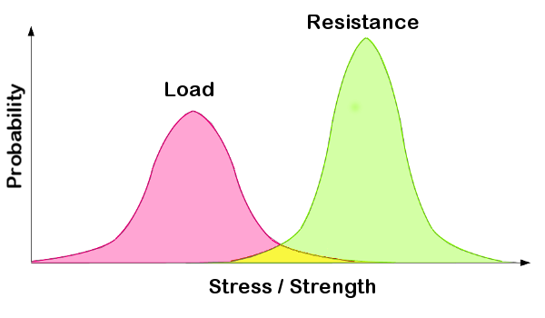
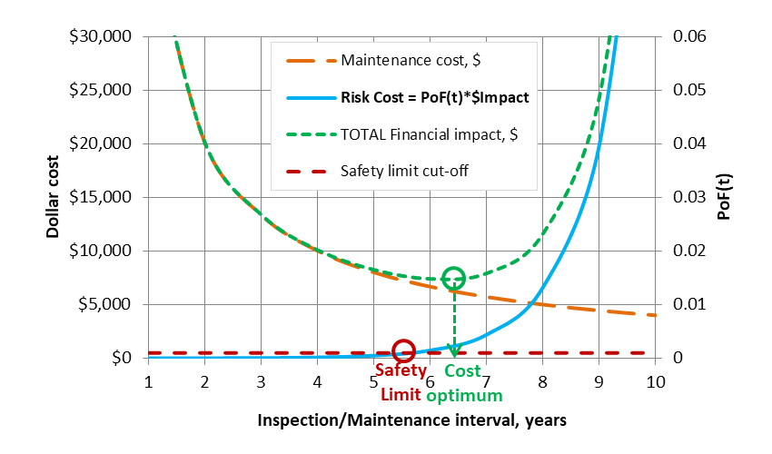
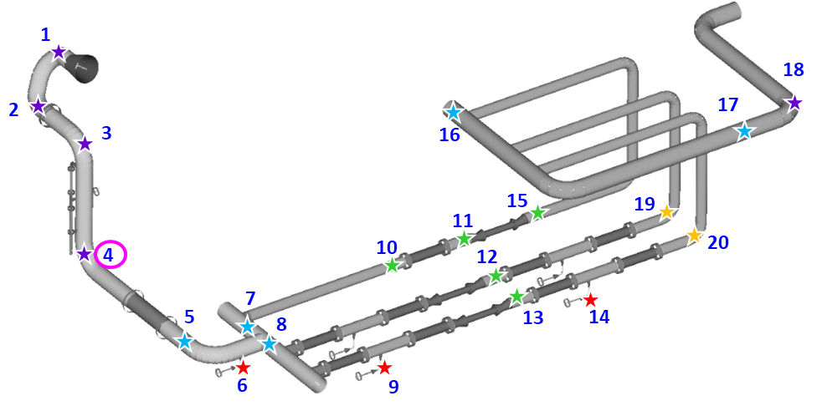

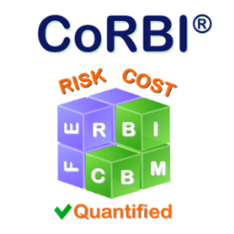
CoRBI® methodology
www.quanty.com.au
8
Notes:
The mentioned coverage issue is that the whole equipment surface is financially prohibitive to inspect.
Therefore suspicious locations are chosen by a non-intrusive inspection planning as a matter of sampling approach.
Getting back to the present RBI, one worst data point is selected for a further analysis.
Question: Imagine, we have performed an advanced NDT inspection instead, but still with a worst data point output. Did we add value?
Therefore, all additional and more precise data should be used in the risk assessment, by applying a statistical plotting.
Here, the green curve refers to the manufacture born wall thickness variation, and the red curve to the actual corrosion instances.
Next we superimpose the load spectrum over the structural resistance spectrum, and their product is the current PoF.
As the corrosion progresses, the yellow overlap increases, and so does the PoF projection to the future.
This step is already sufficient to identify a safety limit breach instance, and thus – the time span for risk controls deployment.
And finally, convert the PoF into the risk cost sought by the client teams and AM practitioners.
The risk cost versus time is now quantified and provides a seamless input into the analysis of costs, benefits and risk control options.

Slide 7
Synergy of tools
Existing integrity data is treated statically
Inspection qualification made on the spot
Coverage and tools recommendation
PoF(t) -> Cost and Safety vs. time
Risk control decisions/budgets/timing
Deployment of recommended CM tools
Damage data refinement and re-analysis loop
Applicable for AM in any industry, even during design
Asset management
Analysis methods
CM & NDT
www.quanty.com.au
6
Notes:
To summarize this technical part, what analysis workflow we propose to renovate the risk management loop:
Statistical analysis of inspection data tells us much about the integrity condition, inspection anomalies and representativeness.
This analysis enables equipment individual PoF estimates, directly converted into the cost and safety implications in the future.
On these grounds, risk control options are selected from the cost/benefit standpoint, including advanced CM where required.
The loop turns around, and the recommended risk controls are deployed to refine the risk estimates as a matter of AM decisions support.
This integrity analysis method is holistic, is applicable in any industry to a wide range of integrity problems and paves the way to the new integrity future.
You are very welcome to take this journey with us. We are looking for co-thinkers to support their efforts of implementing new technologies.

Slide 8
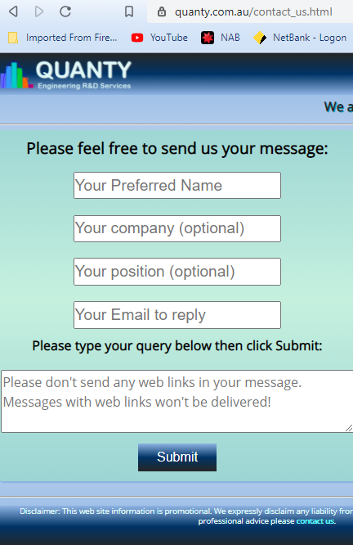
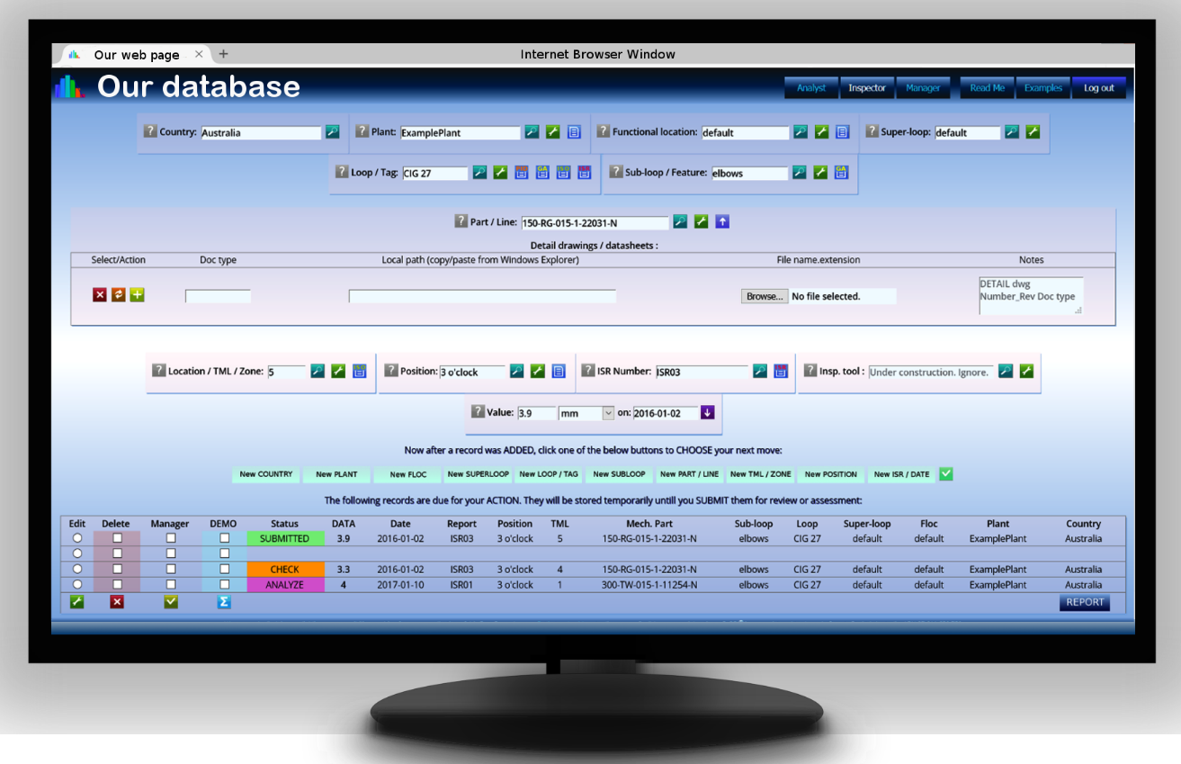
Thank you
www.quanty.com.au
7
Notes:
Please feel free to leave a message at our website or email the address provided in the more detailed conference paper.
We also have a secure integrity data portal to enable the above workflow with flexible roles and paperless features.
Thank you for attention and I hope that we offered some value for your decision making.

Slide 9

Risk analysis in AM
Business Goals
Targets
Capability
Strategy
Monitor
Assess
Control
Acquisition
Operation
Disposal
VALUE
RISK
Asset Management
Life Cycle
Risk Management
www.quanty.com.au
2
Notes:
Client decisions are made according to their business goals.
Business goals may vary, but commonly these are getting most from the plant equipment while maintaining safety and financial risks at tolerable levels.
Asset management process focuses on strategic measures for reaching these goals.
In parallel, there is a Risk management process focusing on particular risks arising from the business operation.
Ideally, both wheels should spin continuously during the whole life cycle of a plant.
In my view, the asset management process relies heavily on the risk management quality.
Because sudden failures of equipment will compromise the value of AM, CM and other integrity measures.
Let me narrow down the scope to inspections of static equipment for cracking and internal corrosion,
which are perhaps the least controllable sources of failure risks.

Slide 10

Failure risk origin
Damage monitoring
Periodic
Inspections
Regular
Surveillance
Live Condition Monitoring
www.quanty.com.au
9
Notes:
The origin of integrity risks is the damage accumulation over time, which is usually non-linear and hard to predict.
Thus the Monitoring component of risk management process is required to collect evidential integrity data.
This can be done using: Regular Surveillance, Live Condition Monitoring and Periodic Inspections
Regular surveillance is applicable where the damage process is clearly visible and slow progressing, like external corrosion, fasteners loosening
Continuous monitoring usually measures side effects of damage, most often – temperature, noise and vibration of rotating machinery
Periodic Inspections apply to individual equipment where the damage is random, hidden and has no side effects, e.g. internal corrosion of pressure vessels for example. Optimization of inspection budgets is an ongoing challenge at industrial plants, as a matter of balancing costs and risks in the environment of unknowns.

Slide 11
Contents
Risk Management role in Asset Management framework
Puzzle 1: Time based integrity control (statutory)
Puzzle 2: Risk Based integrity control (RBI)
Puzzle 3: Probabilistic integrity control (CoRBI®)
Our data analysis workflow to support AM, CM, NDT
www.quanty.com.au
10
Notes:
We will start from high level considerations on why risk management quality is important for asset management success.
Consider why equipment failure risks are a major threat to the plant business goals.
We will see who is interacting in the risk management loop.
Next we will assemble three ‘puzzles’ to see the past, present and future of the risk management process.
I will show our proposed solution in more technical detail.
We will also review the perspectives of advanced integrity monitoring tools in this context.
This sequence will outline a truly Upgraded Integrity Management framework suitable for a range of industries and disciplines.

